Slide 1
Flower Pollination Algorithm

Slide 2
Flower Pollination Algorithm
Flower Pollination Algorithm (FPA) [7]
was developed 2012 by Xin-She Yang
drawing inspiration from the characteristic of the biological flower pollination in flowering plant
Two key features
cross-pollination
self-pollination
A switch probability
Local pollination and
Global pollination

Slide 3
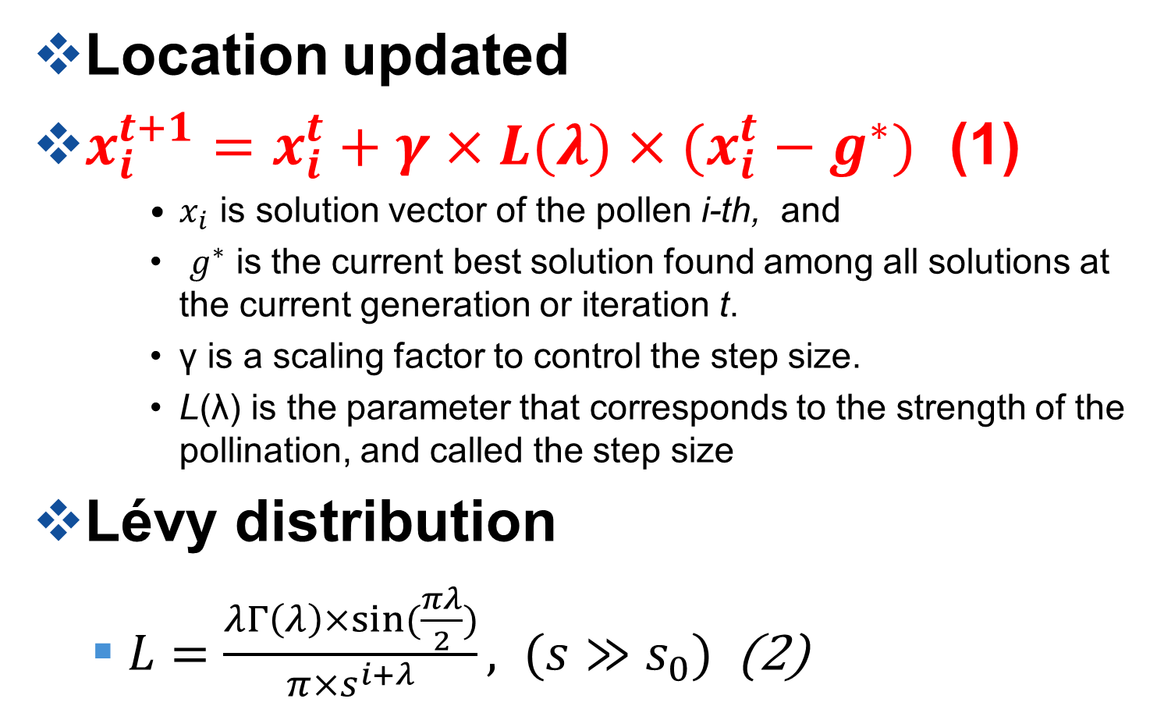
Global pollination: Cross-pollination
Location updated
$x_{i}^{t+1}=x_{i}^{t}+γ×L(λ)×(x_{i}^{t}−g^{∗})$ (1)
$x_{i}$ is solution vector of the pollen i-th, and
$g^{∗}$ is the current best solution found among all solutions at the current generation or iteration t.
γ is a scaling factor to control the step size.
L(λ) is the parameter that corresponds to the strength of the pollination, and called the step size
Lévy distribution
$L=\frac{λΓ\left(λ\right)×sin⁡(\frac{πλ}{2})}{π×s^{i+λ}}, (s≫s_{0})$ (2)

Slide 4
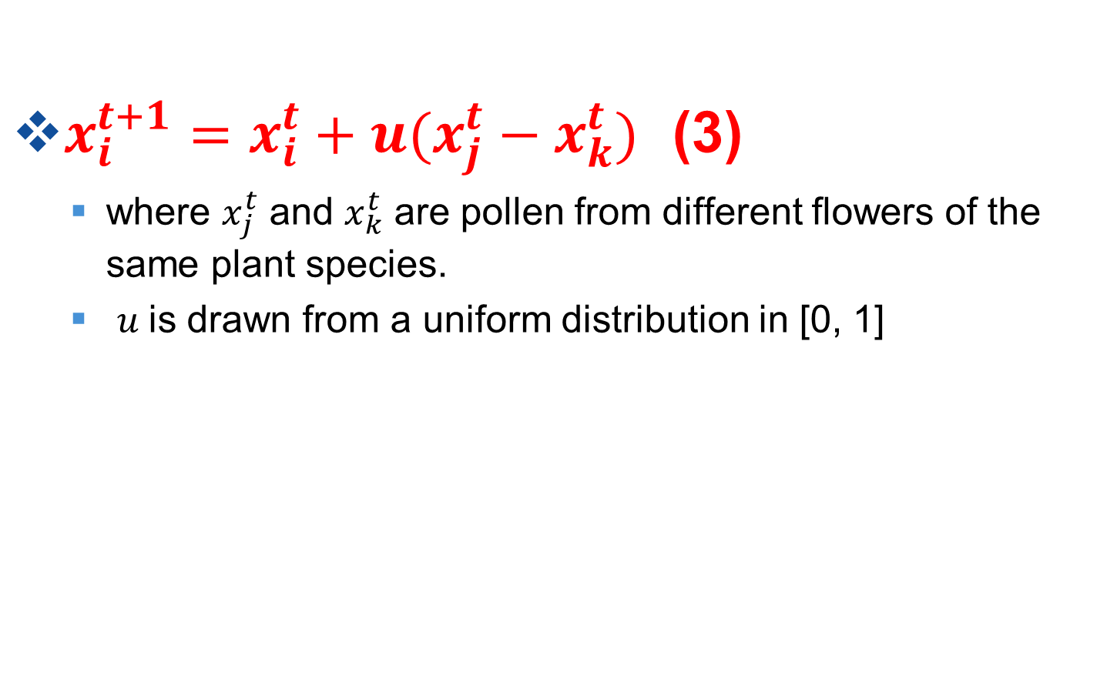
Local pollination: self-pollination
$x_{i}^{t+1}=x_{i}^{t}+u(x_{j}^{t}−x_{k}^{t})$ (3)
where $x_{j}^{t}$ and $x_{k}^{t}$ are pollen from different flowers of the same plant species.
$u$is drawn from a uniform distribution in [0, 1]

Slide 5
Process of this FPA
Step 1. Initialization: pollen population x = (x₁, x₂, .., x_{d}) is generated randomly. A switch probability p ∈ arrange from 0 to 1. A stopping criterion is set.
Step 2. The best solution g* is calculated with initial population, F_{min} is assigned to fitness at g*.
Step 3. For each pollen in the population
if rand < p,
A step vector L is computed as Lévy distribution Eq.(2)
Global pollination is updated via Eq.(1)
else
Draw u from a uniform distribution in [0,1]
Local pollination is processed via Eq.(3)
end if
Step 4. Evaluate new solutions, the function value F_{new} is assigned to fitness(x (t+1). A new solution is accepted if the solution improves (F_{new} less than F_{min}), by updating the best solution g* to x(t+1) and assign the minimum function F_{min} to F_{new}.
Step 5. If the termination condition is not safety, go to Step 3.
Step 6. Output the best solution found.

